Slide 1
Rates of Reaction
Reaction Rates
Definition of Reaction Rate
Experimental Determination of Rate
Dependence of Rate on Concentration
Change of Concentration with Time
Temperature and Rate; Collision and Transition-State Theories
Arrhenius Equation
Reaction Mechanisms
Elementary Reactions
The Rate Law and the Mechanism
Catalysis

Slide 2
Rates of Reaction
Chemical kinetics is the study of reaction rates, how reaction rates change under varying conditions, and what molecular events occur during the overall reaction.
What variables affect reaction rates?
Concentrations of reactants. Often the rate of reaction increases when the concentration of a reactant is increased.
Catalyst. A catalyst is a substance that increases the rate of reaction without being consumed in the overall reaction.
Temperature at which the reaction occurs. Usually reactions speed up when the temperature increases.
Surface area of a solid reactant or catalyst. If a reaction involves a solid with a gas or liquid, the surface area of the solid affects the reaction rate.

Slide 3
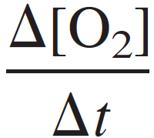
Definition of Reaction Rate
The reaction rate is the increase in molar concentration of product of a reaction per unit time or the decrease in molar concentration of reactant per unit time.
The usual unit of reaction rate is moles per liter per second, mol/(L•s).
Consider the gas-phase reaction discussed in the chapter opening:
2N₂O₅(g) ➔ 4NO₂(g) + O₂(g)
The rate for this reaction could be found by observing the increase in molar concentration of O₂ produced.
The rate of the reaction is given by
Rate of formation of oxygen =

Slide 4
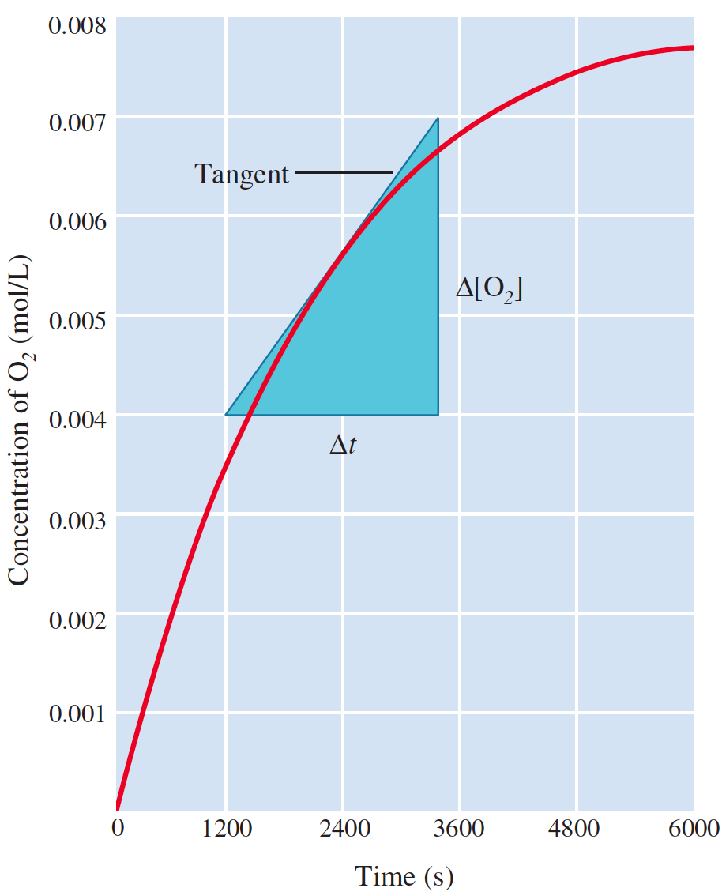
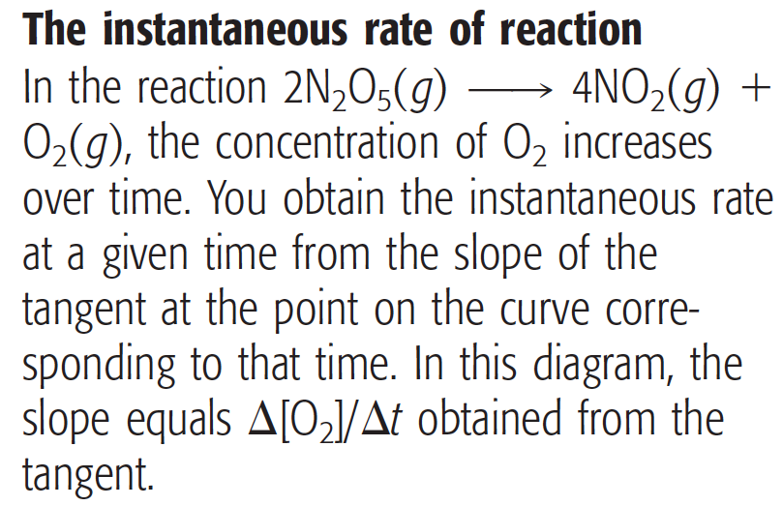
Instantaneous Rate

Slide 5
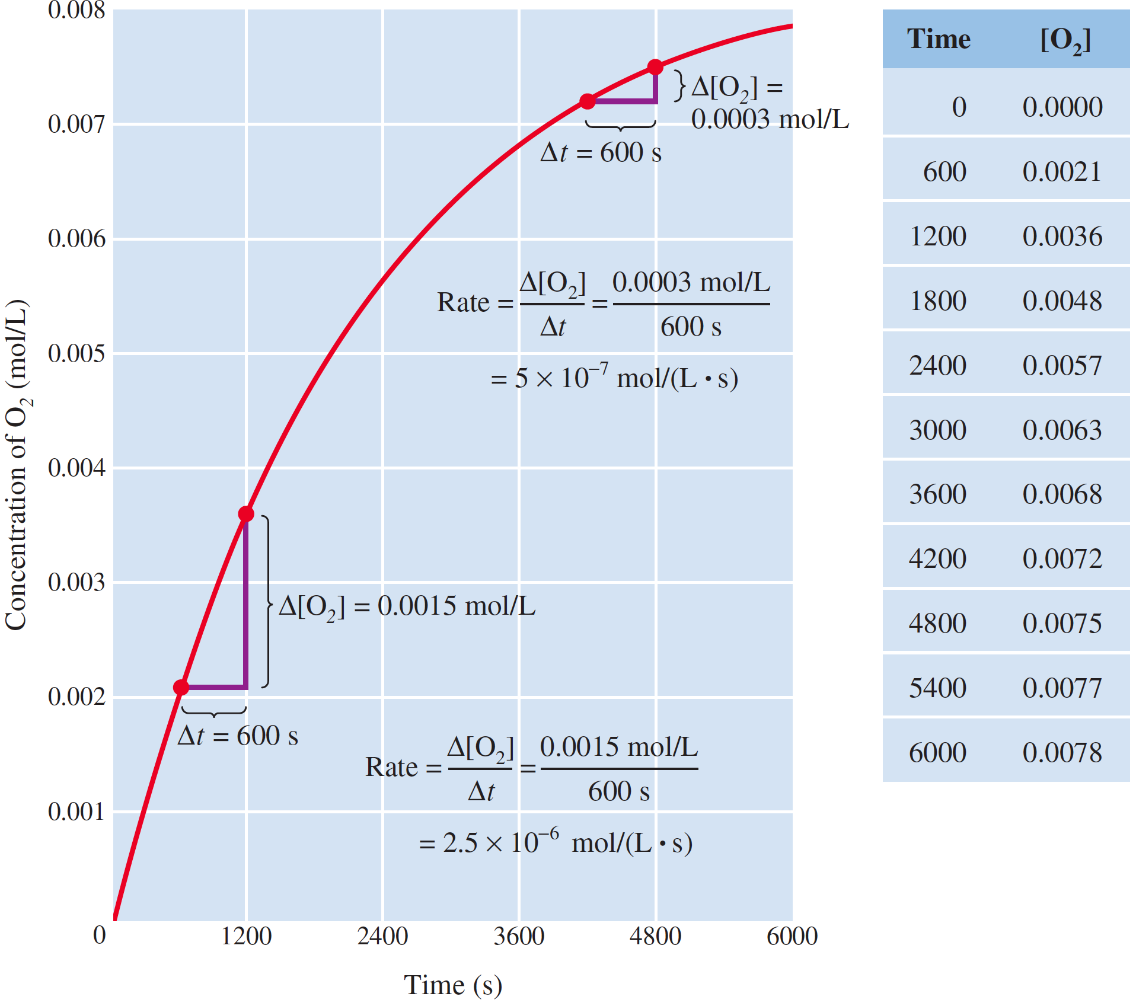
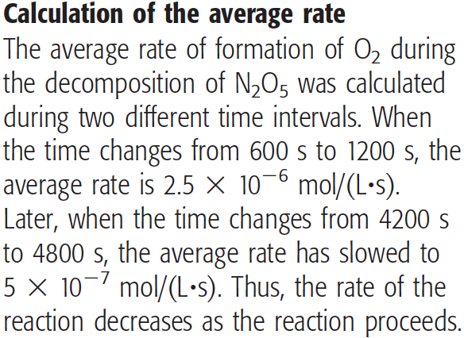
Average Rate

Slide 6
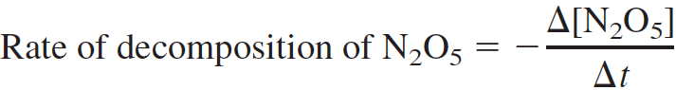
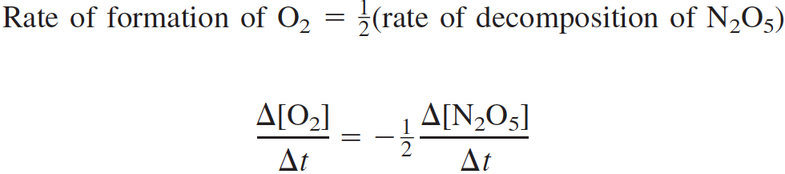
Rate of Decomposition
The amounts of products and reactants are related by stoichiometry, so any substance in the reaction can be used to express the rate of reaction. In the case of the decomposition of N₂O₅ to NO₂ and O₂, the rate is expressed in terms of the rate of formation of oxygen, Δ[O₂]/Δt. However, it can also be expressed in terms of the rate of decomposition of N₂O₅.

Slide 7
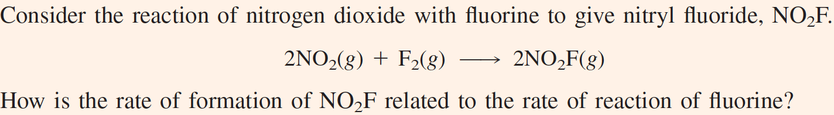
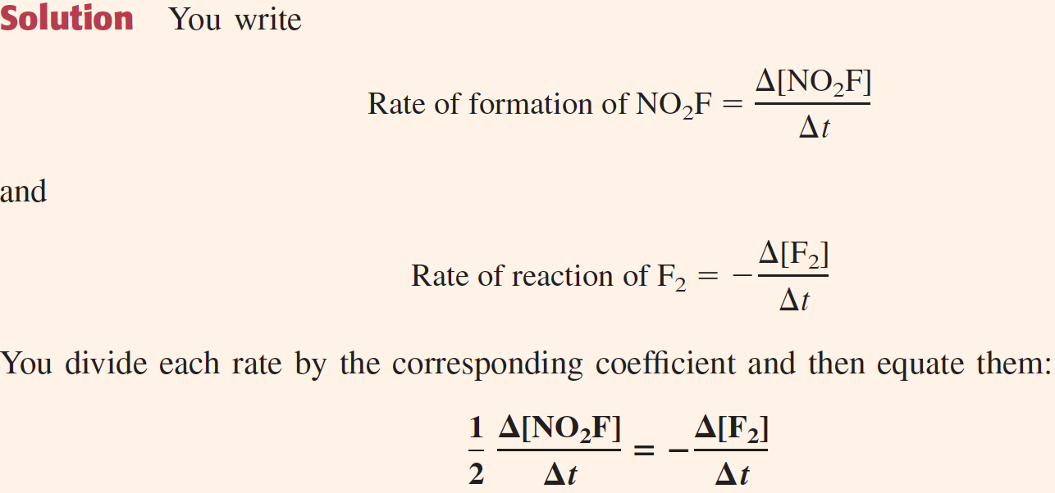

Slide 8
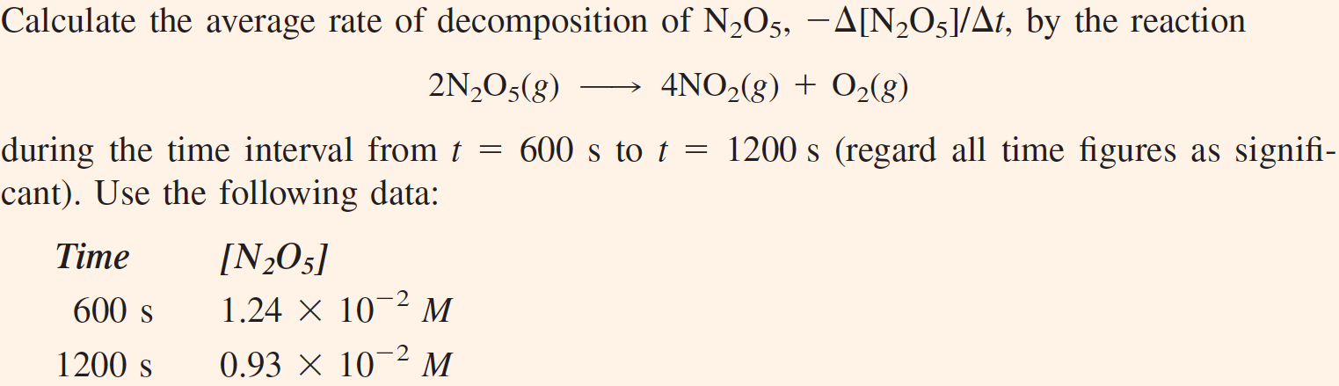
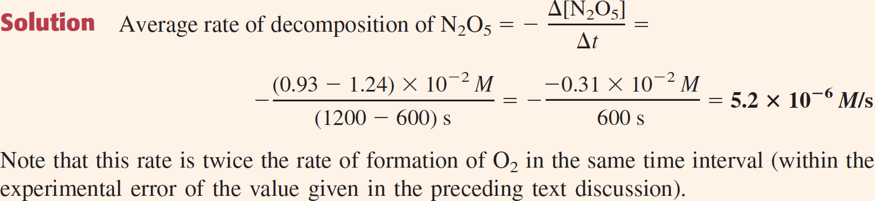

Slide 9
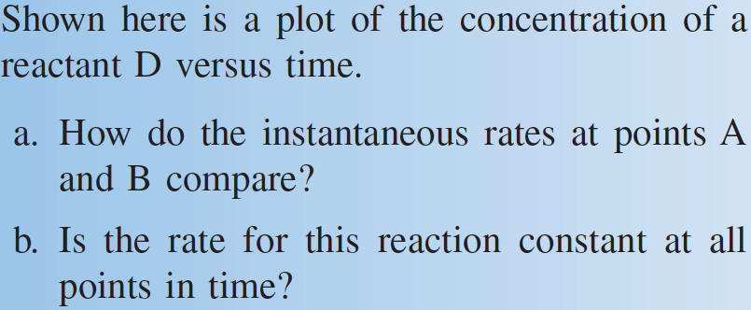
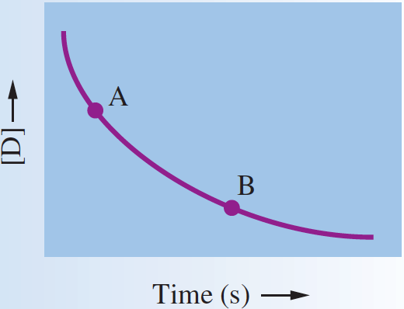

Slide 10
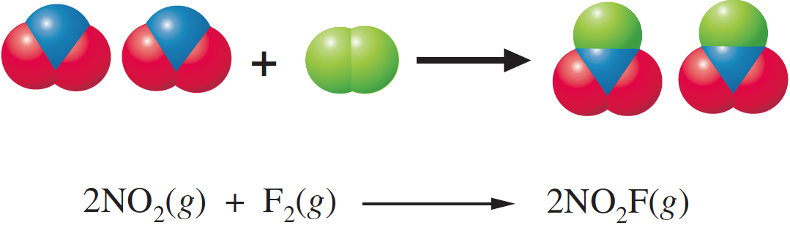
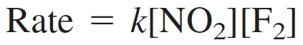
Dependence of Rate on Concentration
A rate law is an equation that relates the rate of a reaction to the concentrations of reactants (and catalyst) raised to various powers. The following equation is the rate law for the foregoing reaction:
Here k, called the rate constant, is a proportionality constant in the relationship between rate and concentrations.

Slide 11
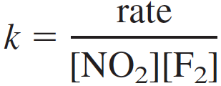
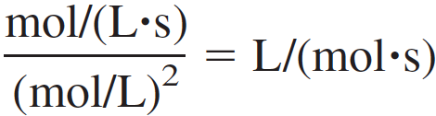
Rate Constant
The rate constant, k, is a proportionality constant in the relationship between rate and concentrations.
It has a fixed value at any given temperature, but it varies with temperature. Whereas the units of rate are usually given as mol/(L•s), the units of k depend on the form of the rate law.
from which you get the following unit for k:

Slide 12
Rate Constant
As a more general example, consider the reaction of substances A and B to give D and E, according to the balanced equation
You could write the rate law in the form
Rate = k[A]^{m}[B]^{n}[C]^{p}
The exponents m, n, and p are frequently, but not always, integers. They must be determined experimentally and they cannot be obtained simply by looking at the balanced equation.

Slide 13
Reaction Order
The reaction order with respect to a given reactant species equals the exponent of the concentration of that species in the rate
law, as determined experimentally.
For the reaction of NO₂ with F₂ to give NO₂F, the reaction is first order with respect to the NO₂ because the exponent of [NO₂] in the rate law is 1. Similarly, the reaction is first order with respect to F₂.
The overall order of a reaction equals the sum of the orders of the reactant species in the rate law. In this example, the overall order is 2; that is, the reaction is second order overall.

Slide 14
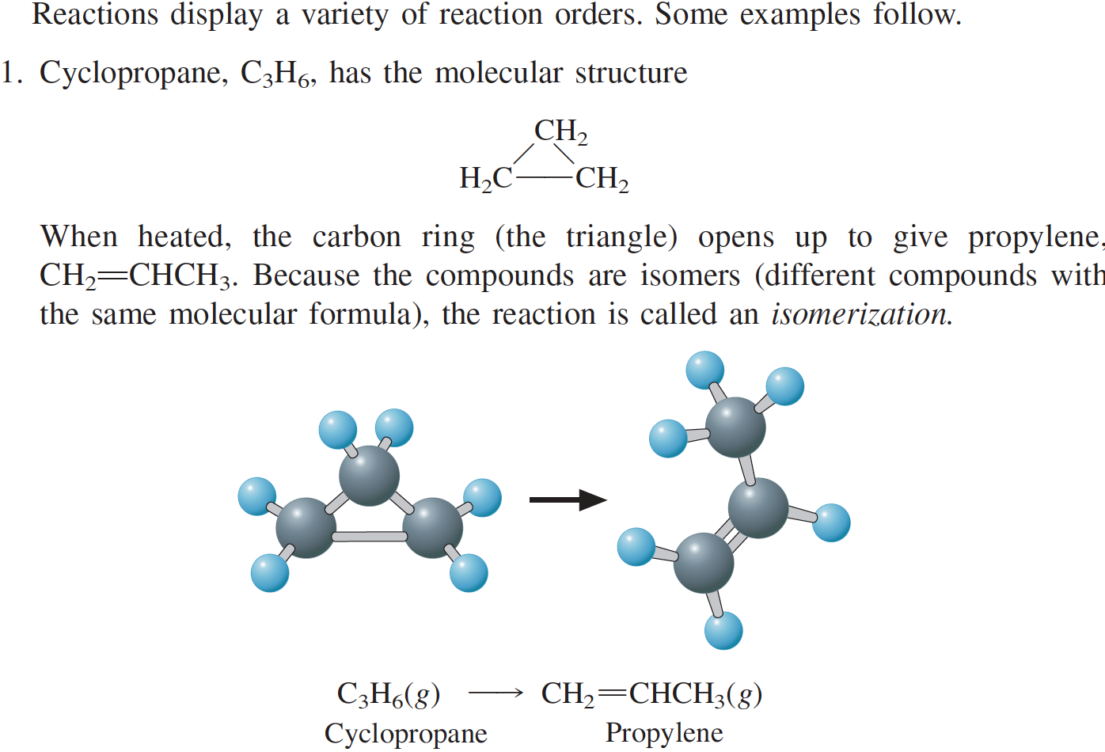
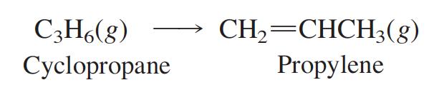
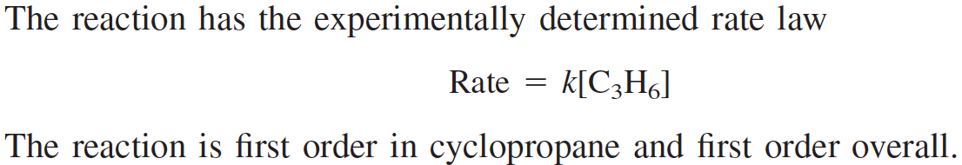

Slide 15
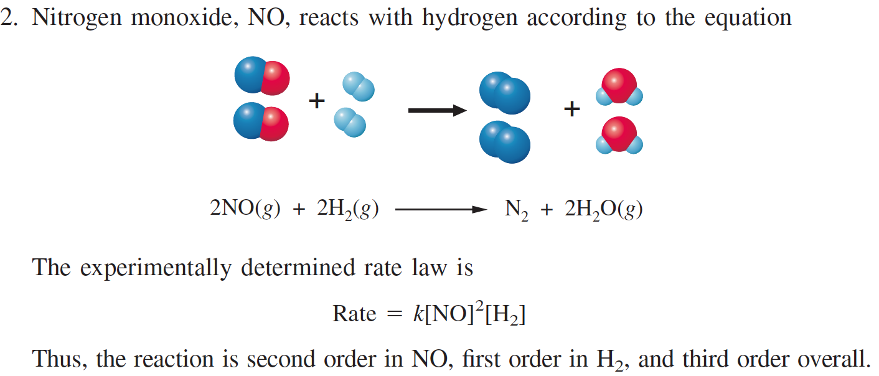
Reaction Order

Slide 16
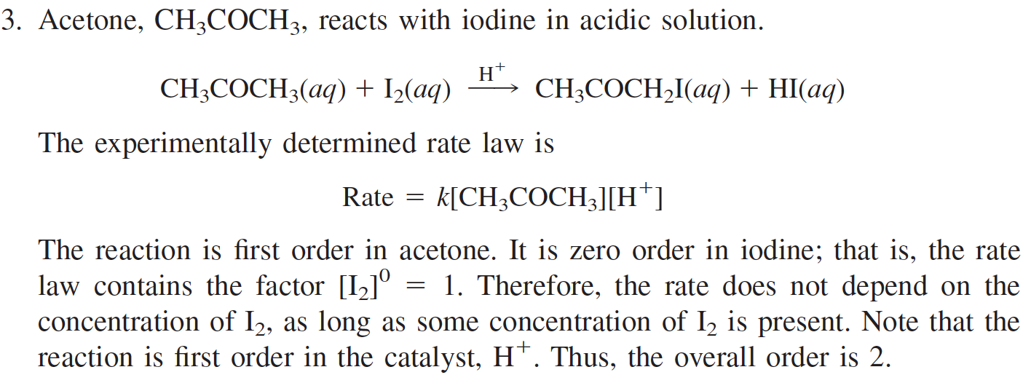
Reaction Order

Slide 17
Reaction Order
Reaction orders frequently have whole-number values (particularly 1 or 2),
They can be fractional.
Zero order reactions are possible
Negative orders are also possible.

Slide 18
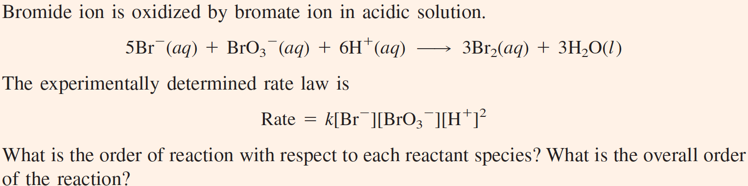

Slide 19
Determining the Rate Law
The experimental determination of the rate law for a reaction requires that you find the order of the reaction with respect to each reactant and any catalyst.
The initial rate method is a simple way to obtain reaction orders. It consists of doing a series of experiments in which the initial, or starting concentrations of reactants are varied.
Then the initial rates are compared, from which the reaction orders can be deduced.
To see how this method works, again consider the reaction
2N₂O₅(g) ➔ 4NO₂(g) + O₂(g)

Slide 20
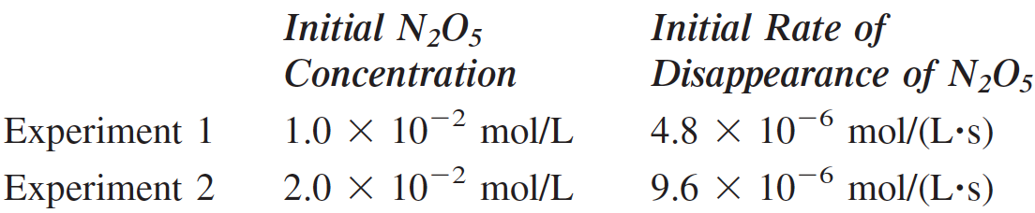
Initial Rate Method
2N₂O₅(g) ➔ 4NO₂(g) + O₂(g)
In Experiment 2, the initial concentration of N₂O₅ is twice that in Experiment 1.
In Experiment 2, initial rate of disappearance of N₂O₅ is twice that in Experiment 1.

Slide 21
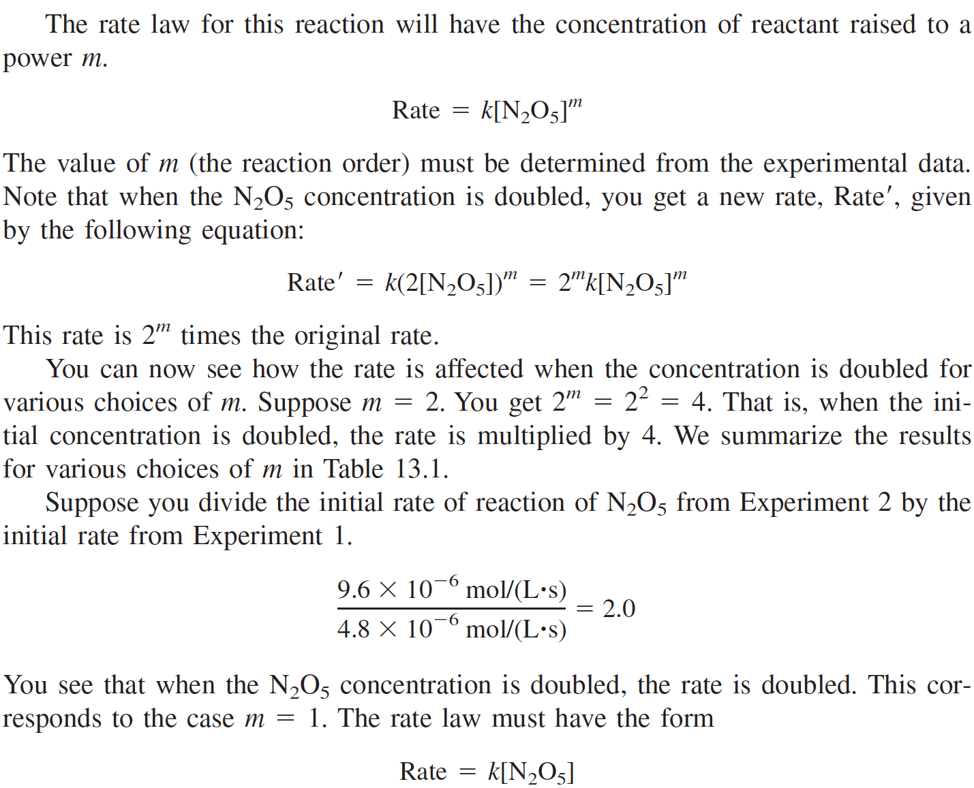

Slide 22
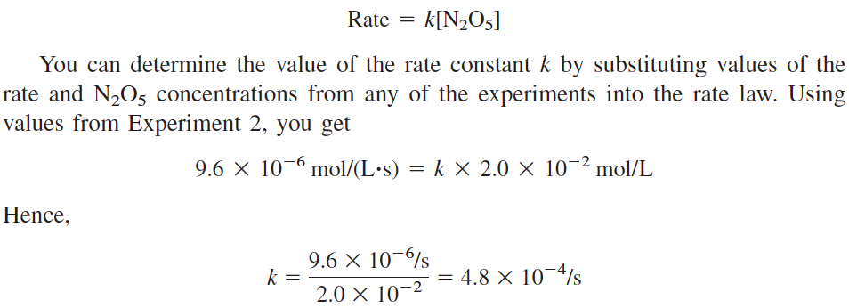

Slide 23
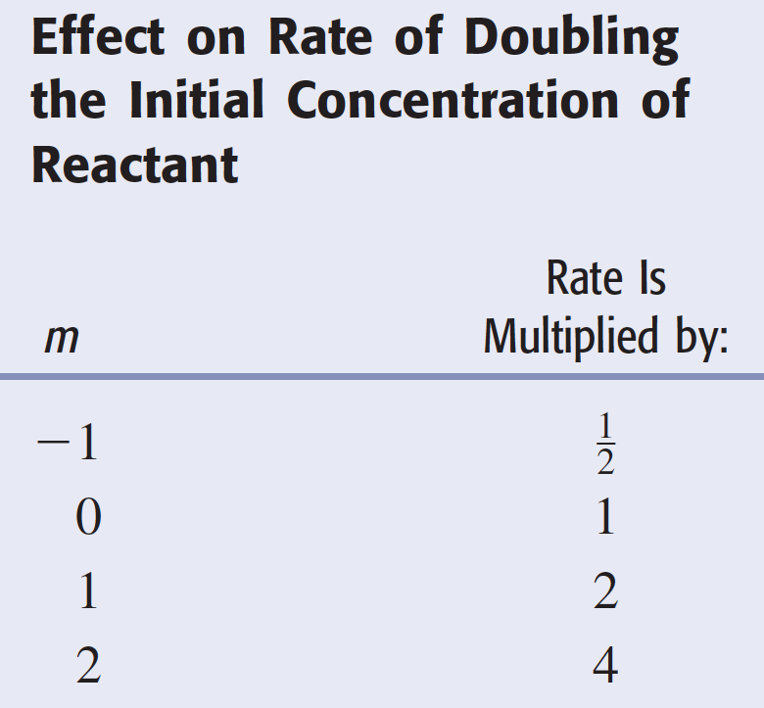

Slide 24
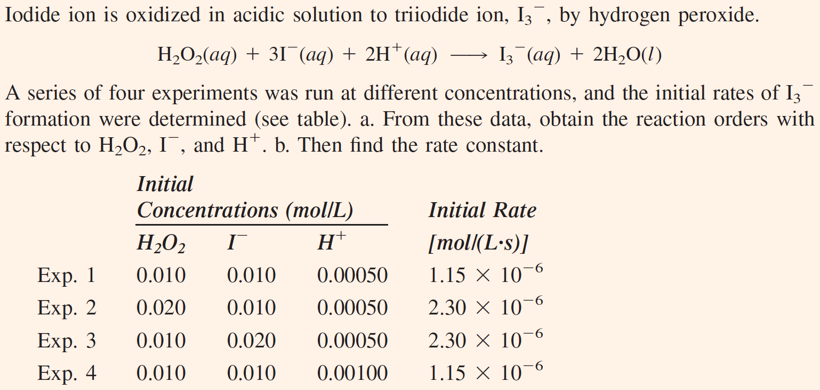

Slide 25
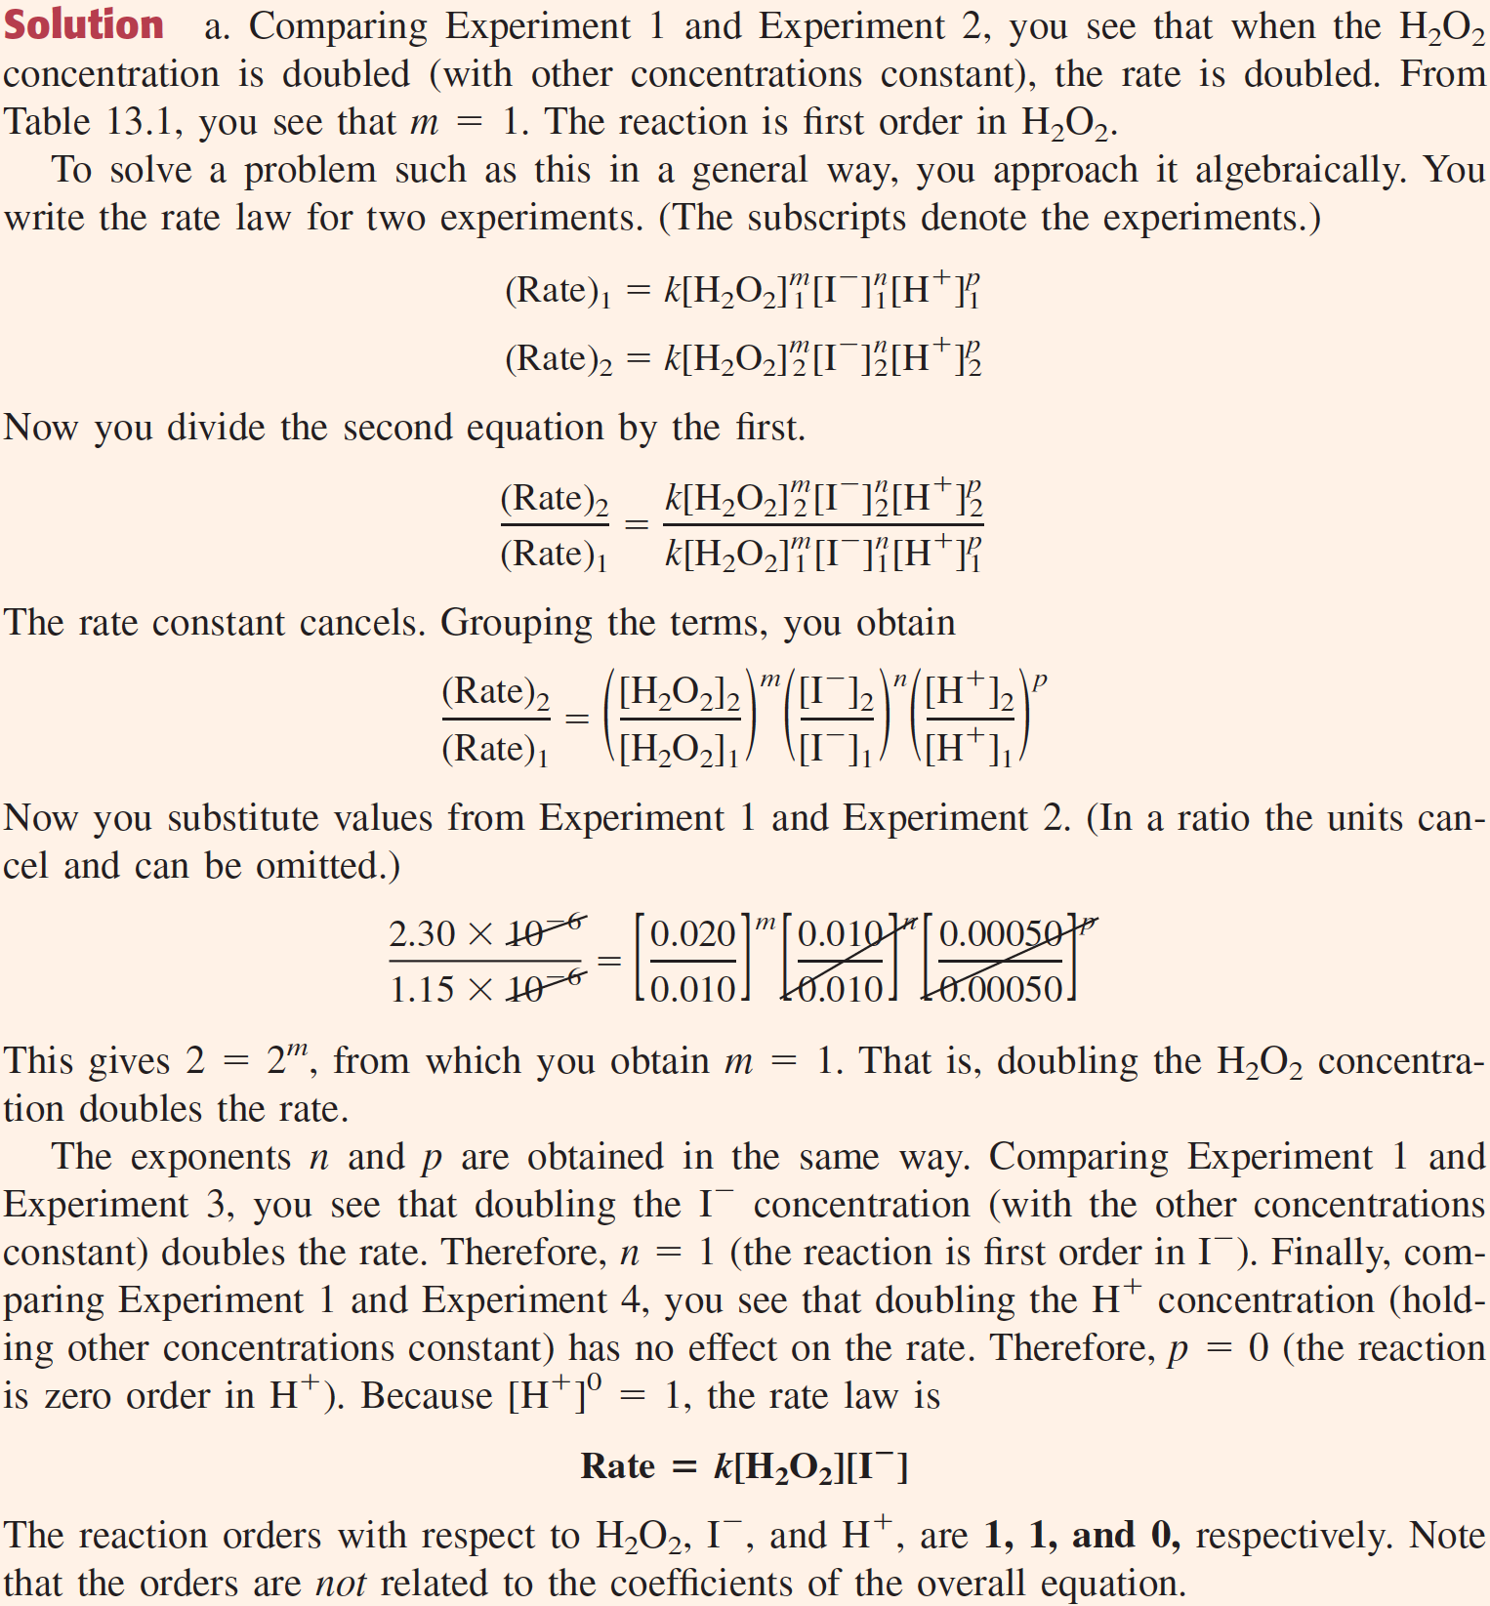

Slide 26
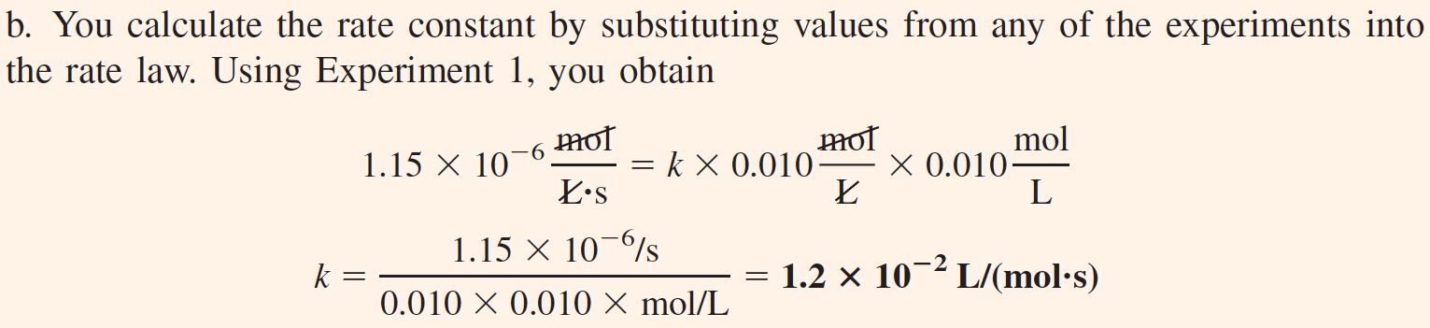

Slide 27
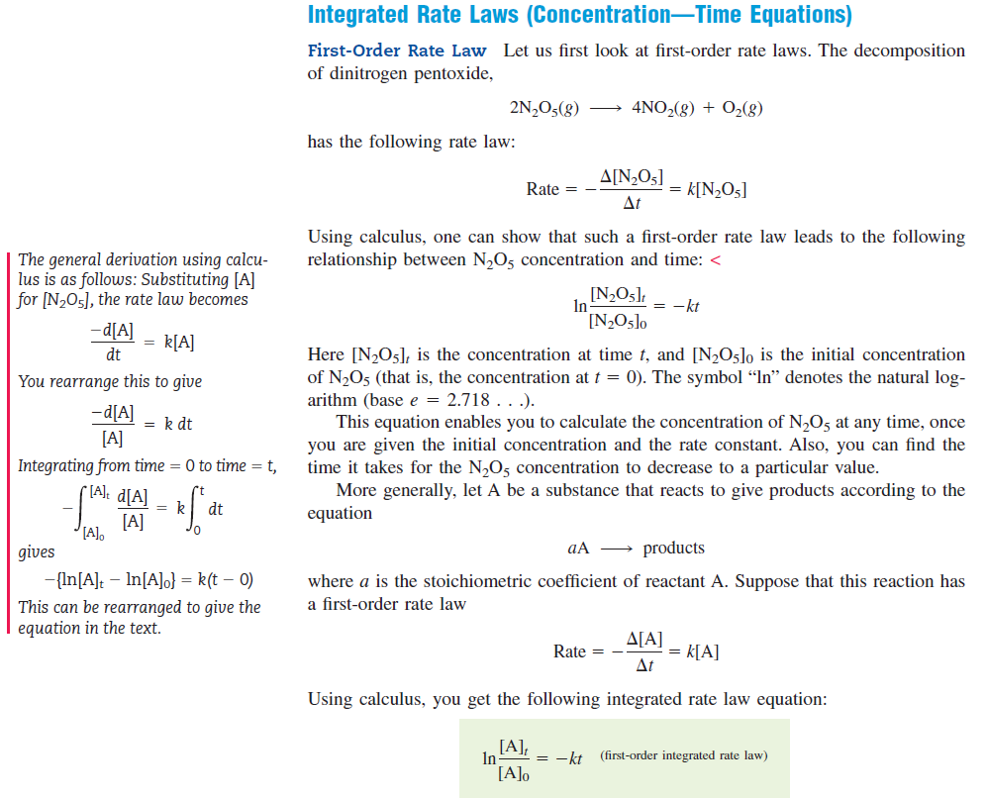

Slide 28
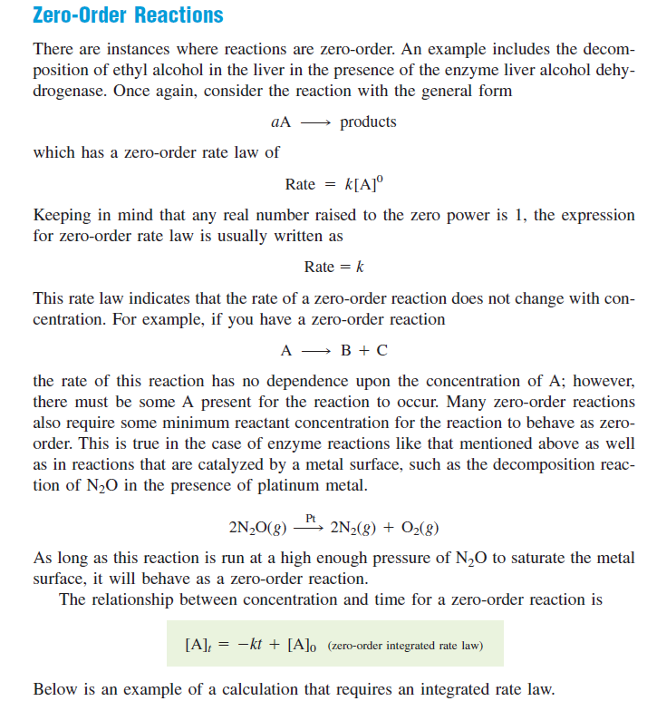

Slide 29
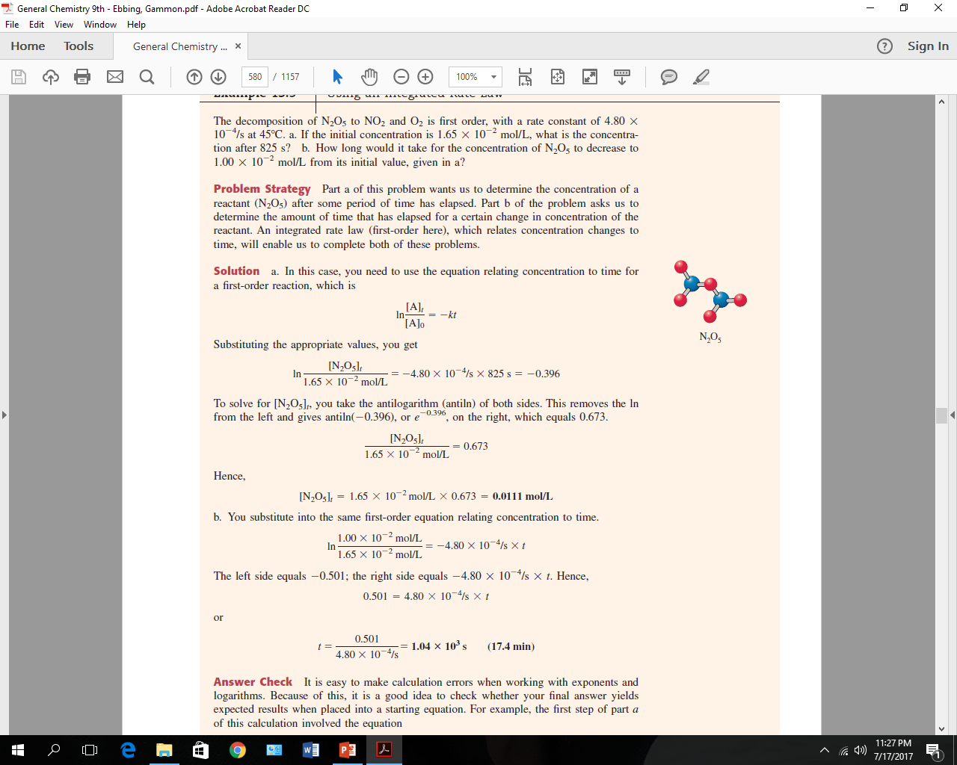

Slide 30
Collision theory
The collision theory of reaction rate attempts to account for the observed kinetics of reactions in terms of molecular behavior of reacting system. In collision theory, in order to a reaction to happens, the reactant molecules must
Collide
Possess or collide with sufficient energy for them to be activated
Collide with proper orientation
Thus according to the theory, the rate constant for a reaction is given by the product of three factors
The collision frequency (z): It can be defined by the number of molecules colliding per area per time in a reacting system containing 1 mole of reactant in 1 liter.
The fraction of collision having energy equal to or greater than the energy of activation. It can be expressed by f
The fraction of collision that occur with reactant molecules properly oriented, sometimes called steric factor and can be expressed as p

Slide 31
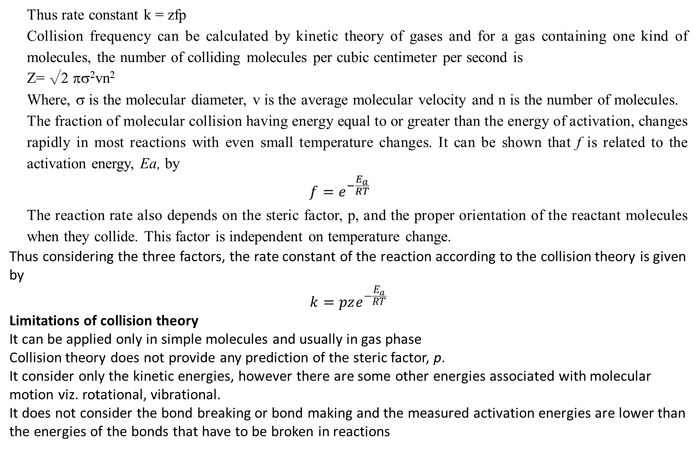
Thus rate constant k = zfp
Collision frequency can be calculated by kinetic theory of gases and for a gas containing one kind of molecules, the number of colliding molecules per cubic centimeter per second is
Z= √2 πσ²vn²
Where, σ is the molecular diameter, v is the average molecular velocity and n is the number of molecules.
The fraction of molecular collision having energy equal to or greater than the energy of activation, changes rapidly in most reactions with even small temperature changes. It can be shown that f is related to the activation energy, Ea, by
$$f=e^{−\frac{E_{a}}{RT}}$$
The reaction rate also depends on the steric factor, p, and the proper orientation of the reactant molecules when they collide. This factor is independent on temperature change.
Thus considering the three factors, the rate constant of the reaction according to the collision theory is given by
$$k=pze^{−\frac{E_{a}}{RT}}$$
Limitations of collision theory
It can be applied only in simple molecules and usually in gas phase
Collision theory does not provide any prediction of the steric factor, p.
It consider only the kinetic energies, however there are some other energies associated with molecular motion viz. rotational, vibrational.
It does not consider the bond breaking or bond making and the measured activation energies are lower than the energies of the bonds that have to be broken in reactions

Slide 32
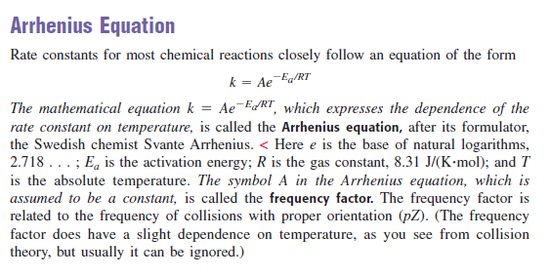

Slide 33
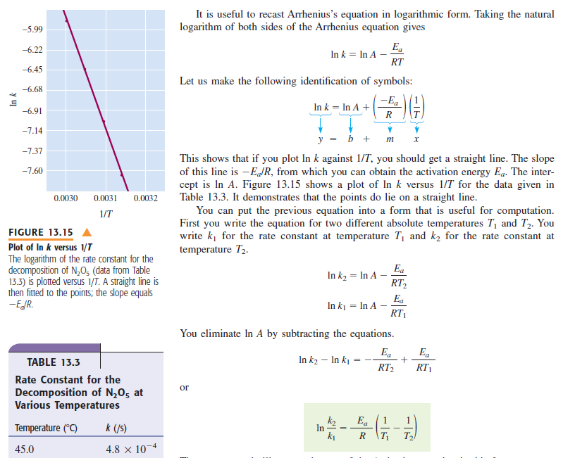

Slide 34
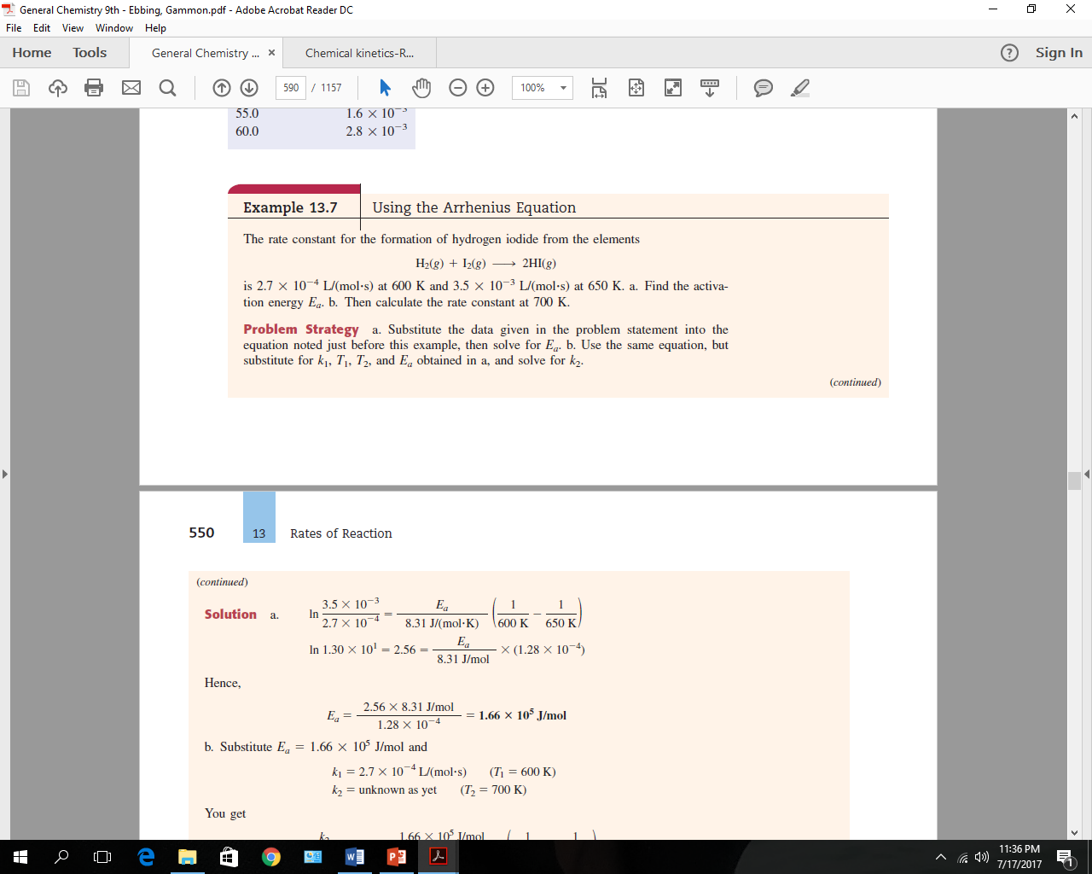
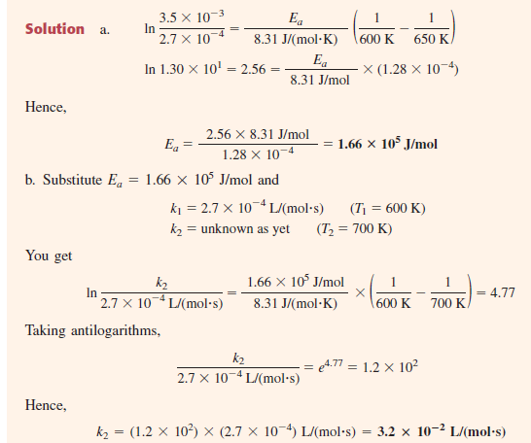

Slide 35
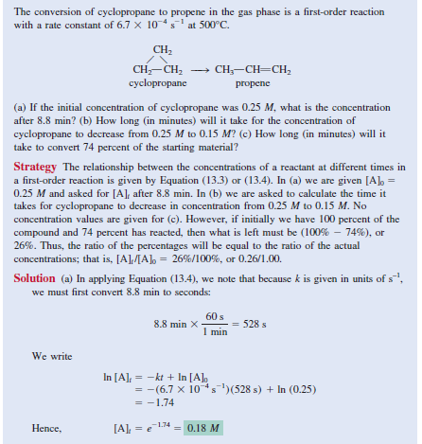

Slide 36
